Slide 1
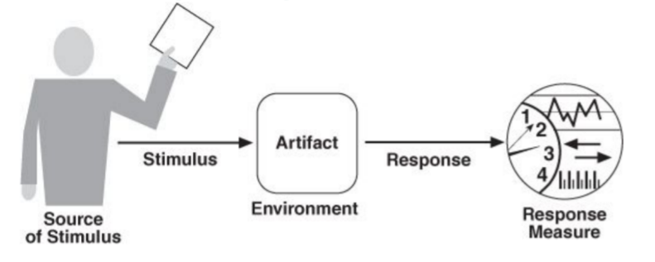
depend 1
MTBF: not less than 1 hours
MTTR: not less than 30 minutes
MTTF: not less than 2 hours
physical
infrastructure
use backup
hardware support
hardware
failure
runtime
physical
infrastructure

Slide 2
depend 1
MTBF: not less than 1 month
MTTR: not less than 1 day
MTTF: not less than 3 months
code
user finds and reports a bug in the system
repair and fix the fault
runtime or maintenance time
end user

Slide 3
secure 1
Cost of data recovery should be less than 1000 dollars; Time to restore the lost data should be less than 1 hour
physical
infrastructure
data loss resulting from hardware failure
use backup
hardware support
runtime
physical
infrastructure

Slide 4
secure 2
the cost of detect and defend the attack should be less than 1000 dollars; the time to make up for the loss should be shorter than 1 day
code
malicious attack
detect and defend the malicious code attack
runtime and design time
system requiring data confidentiality

Slide 5
sustainability 1
the rate of the affected components should be less than 1%; time to make the change should be less than 1 hour
coda,
components
wish to change to a different platform
port the system from one platform to another
runtime
design time
developer

Slide 6
sustainability 2
time to add the new function should be less than one week; number of affected components should be less than 5
code, interfaces
require to add new functions
extend the system’s ability/meet new requirements
runtime, design time
product manager

Slide 7
scalability 1
time to respond to each request should be less than one minute; the increase of the cost to respond to each request should be less than 30%
code, resources
sudden increase in user request
allocate new resources to satisfy the increased load or demand
runtime, design time,
transient increase in demand
system administrator

Slide 8
scalability 2
time to respond to the user should be less than 1 second; cost of developing and applying the allocation algorithm should be less than 10000 dollars
physical
infrastructure, code
ask for shorter response time
design better algorithm to boost the efficiency of resource allocation
runtime,
maintenance time, design time
end user

Slide 9
secure 1

Slide 10
secure 2

Slide 11
sustainability 1

Slide 12
sustainability 2

Slide 13
scalability 1

Slide 14
scalability 2

